Slide 1
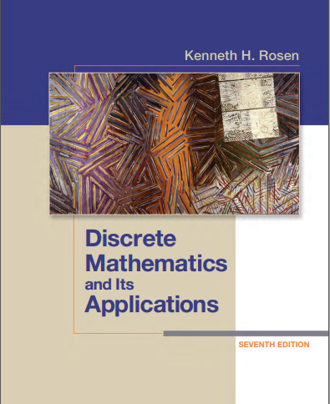

Discrete structures
By Dr. sajid iqbal
Course Reference Book

Slide 2
Logical Connectives
Discrete structures
A logical operator that forms a new proposition using 2 or more propositions

Slide 3
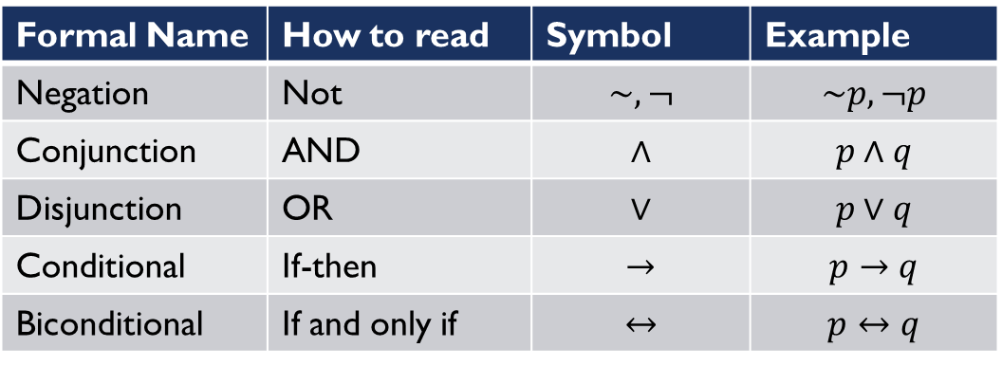
Logical Connectives
Formal Name | How to read | Symbol | Example
Negation | Not | $$\sim , ¬$$ | $$\sim p, ¬p$$
Conjunction | AND | $$∧$$ | $$p∧q$$
Disjunction | OR | $$∨$$ | $$p∨q$$
Conditional | If-then | $$→$$ | $$p→q$$
Biconditional | If and only if | $$↔$$ | $$p↔q$$

Slide 4
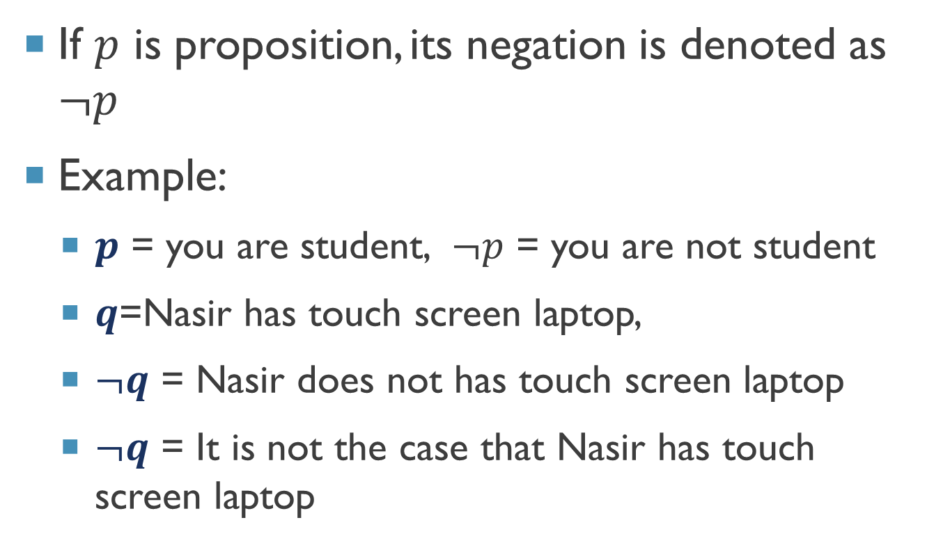

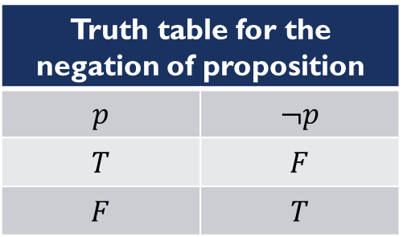
Negation of Proposition ($¬$)
If $p$ is proposition, its negation is denoted as $¬p$
Example:
$p$ = you are student, $¬p$ = you are not student
$q$=Nasir has touch screen laptop,
$¬q$ = Nasir does not has touch screen laptop
$¬q$ = It is not the case that Nasir has touch screen laptop
Truth table for the negation of proposition
$$p$$ | $$¬p$$
$$T$$ | $$F$$
$$F$$ | $$T$$
# p = the value is less than 10 p=8 print(p<10) # p = True p=15 print(p<10) # p = False p=8 print(not(p<10)) # p = False p=15 print(not(p<10)) # p = True

Slide 5
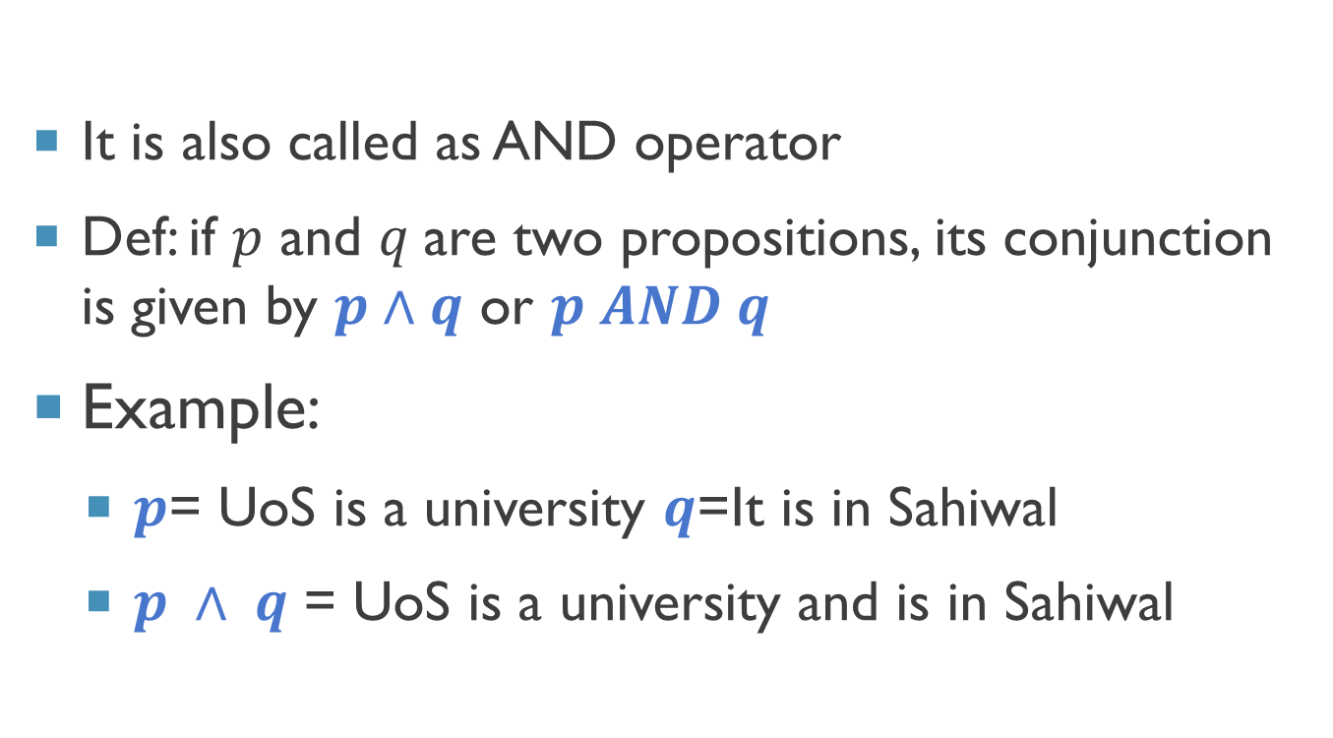

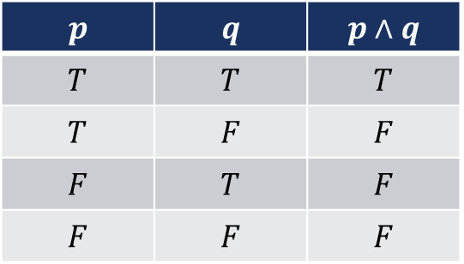
Conjunction operator ($∧$)
It is also called as AND operator
Def: if $p$ and $q$are two propositions, its conjunction is given by $p∧q$ or $p AND q$
Example:
$p$= UoS is a university $q$=It is in Sahiwal
$p ∧ q$ = UoS is a university and is in Sahiwal
$$p$$ | $$q$$ | $$p∧q$$
$$T$$ | $$T$$ | $$T$$
$$T$$ | $$F$$ | $$F$$
$$F$$ | $$T$$ | $$F$$
$$F$$ | $$F$$ | $$F$$
# p = the value is less than 10 # q = the value is less than 20 p,q=8,16 print(p<10 and q<20) # T and T = T p,q=8,26 print(p<10 and q<20) # T and F = F p,q=18,16 print(p<10 and q<20) # F and T = F p,q=18,26 print(p<10 and q<20) # F and F = F

Slide 6
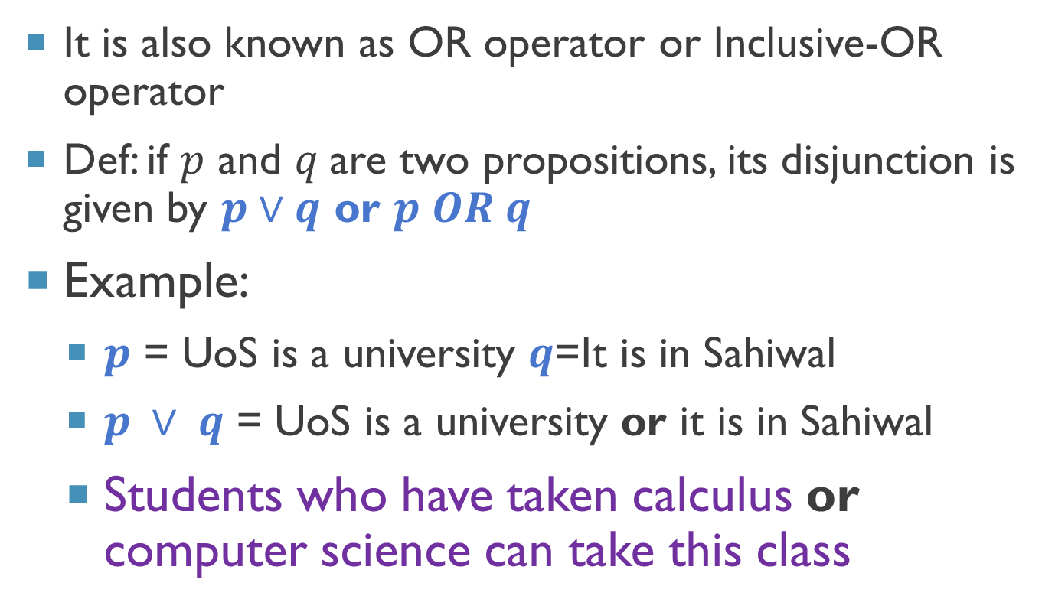

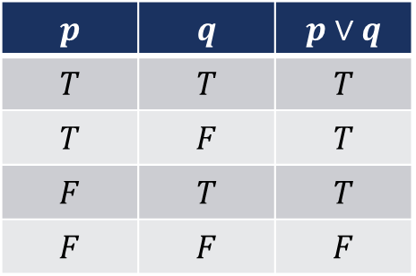
Disjunction operator ($∨$)
It is also known as OR operator or Inclusive-OR operator
Def: if $p$ and $q$are two propositions, its disjunction is given by $p∨q$ or $p OR q$
Example:
$p$ = UoS is a university $q$=It is in Sahiwal
$p ∨ q$ = UoS is a university or it is in Sahiwal
Students who have taken calculus or computer science can take this class
$$p$$ | $$q$$ | $$p∨q$$
$$T$$ | $$T$$ | $$T$$
$$T$$ | $$F$$ | $$T$$
$$F$$ | $$T$$ | $$T$$
$$F$$ | $$F$$ | $$F$$
# p = the value is less than 10 # q = the value is less than 20 p,q=8,16 print(p<10 or q<20) # T or T = T p,q=8,26 print(p<10 or q<20) # T or F = T p,q=18,16 print(p<10 or q<20) # F or T = T p,q=18,26 print(p<10 or q<20) # F or F = F

Slide 7
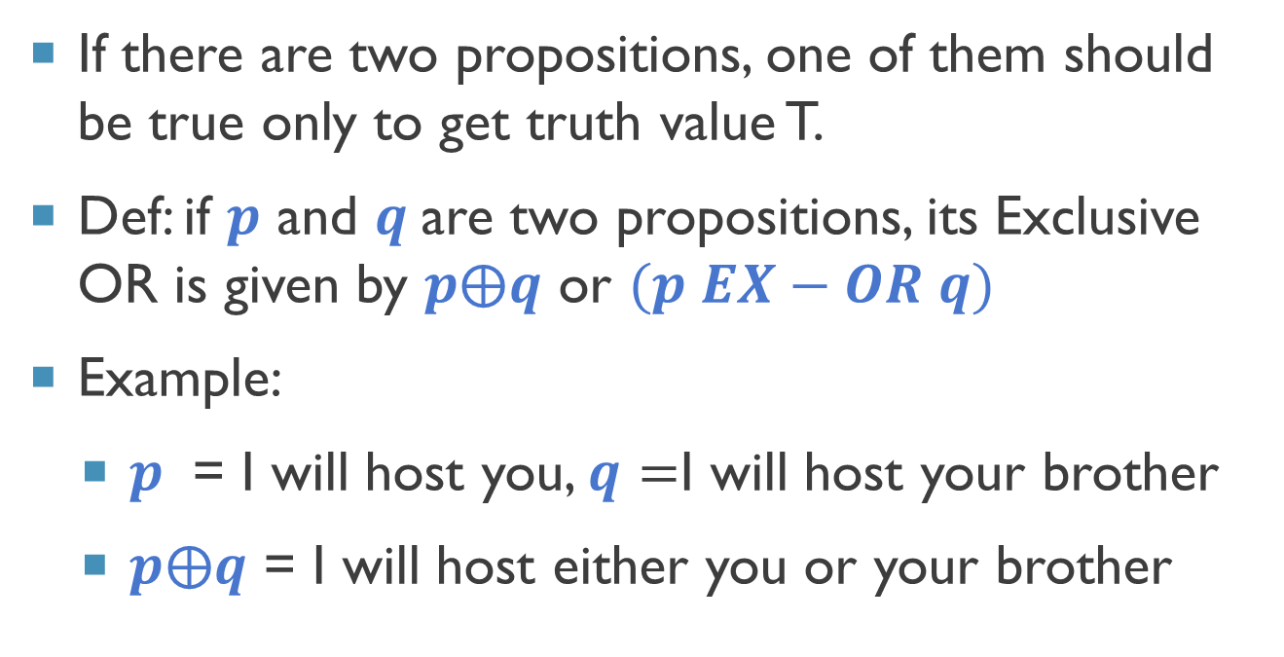

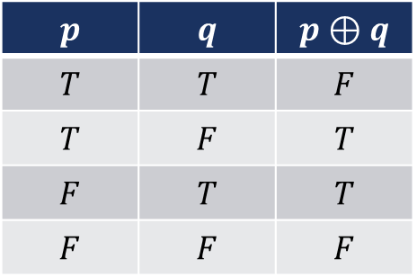
Exclusive OR ($⊕$)
$$p$$ | $$q$$ | $$p⊕q$$
$$T$$ | $$T$$ | $$F$$
$$T$$ | $$F$$ | $$T$$
$$F$$ | $$T$$ | $$T$$
$$F$$ | $$F$$ | $$F$$
If there are two propositions, one of them should be true only to get truth value T.
Def: if $p$ and $q$are two propositions, its Exclusive OR is given by $p⨁q$ or $(p EX−OR q)$
Example:
$p$ = I will host you, $q=$I will host your brother
$p⨁q$ = I will host either you or your brother
# p = the value is less than 10 # q = the value is less than 20 p,q=8,16 print((p<10) !=(q<20)) # T xor T = F p,q=8,26 print((p<10)!=(q<20)) # T xor F = T p,q=18,16 print((p<10)!=(q<20)) # F xor T = T p,q=18,26 print((p<10)!=(q<20)) # F xor F = F

Slide 8
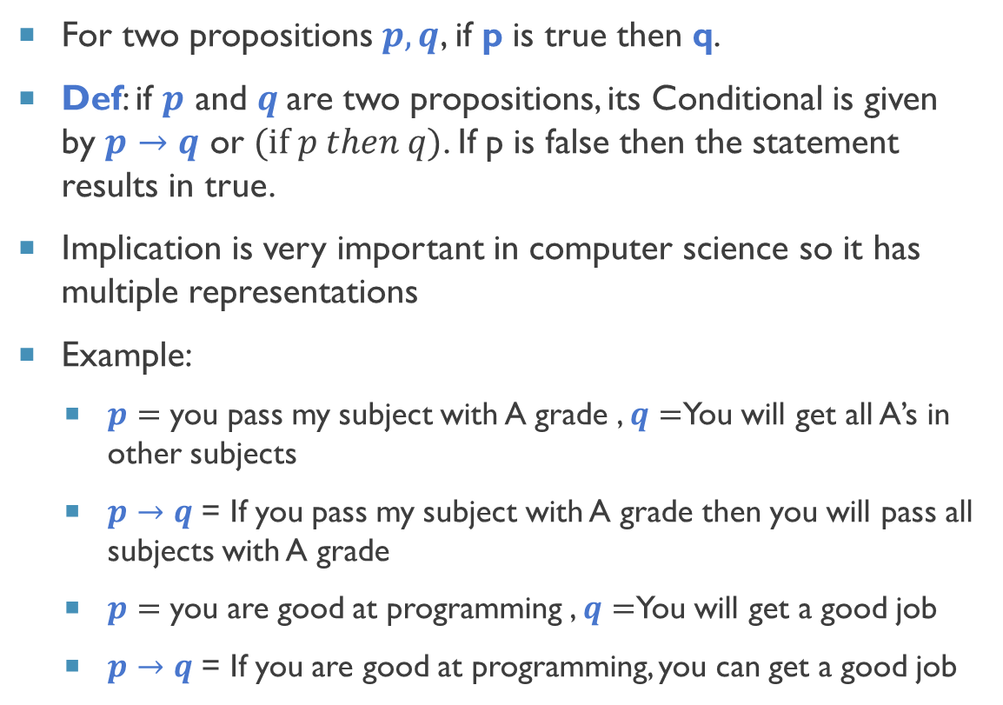

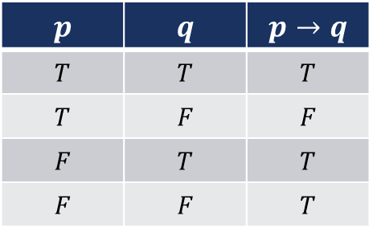
Conditional (implication) Statement ($→$)
For two propositions $p,q$, if p is true then q.
Def: if $p$ and $q$are two propositions, its Conditional is given by $p→q$ or $(if p then q)$. If p is false then the statement results in true.
Implication is very important in computer science so it has multiple representations
Example:
$p=$ you pass my subject with A grade , $q=$You will get all A’s in other subjects
$p→q$ = If you pass my subject with A grade then you will pass all subjects with A grade
$p=$ you are good at programming , $q=$You will get a good job
$p→q$ = If you are good at programming, you can get a good job
$$p$$ | $$q$$ | $$p→q$$
$$T$$ | $$T$$ | $$T$$
$$T$$ | $$F$$ | $$F$$
$$F$$ | $$T$$ | $$T$$
$$F$$ | $$F$$ | $$T$$
p,q=8,16 if(p<10): # T print(q<20) # T p,q=8,26 if(p<10): # T print(q<20) # F p,q=18,16 if(p<10): # F print(q<20) # T ? p,q=18,26 if(p<10): # F print(q<20) # F ?

Slide 9
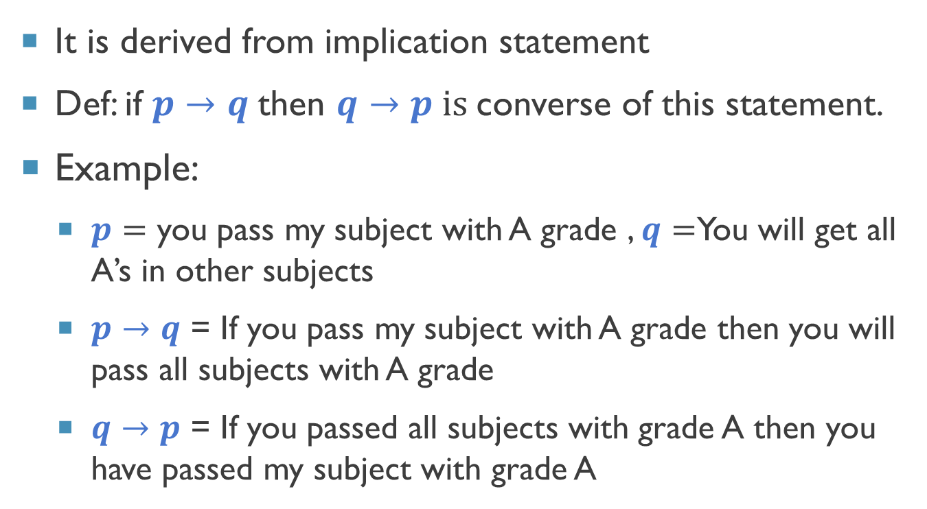

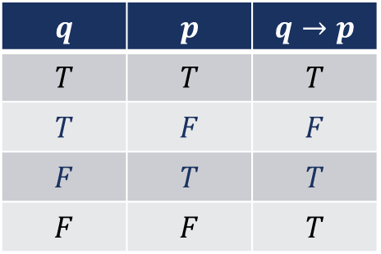
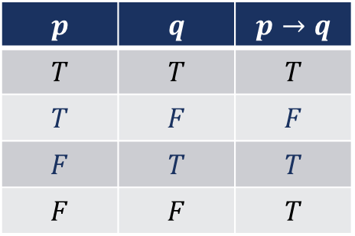
Converse Statement ($→$)
It is derived from implication statement
Def: if $p→q$then $q→p is$converse of this statement.
Example:
$p=$ you pass my subject with A grade , $q=$You will get all A’s in other subjects
$p→q$ = If you pass my subject with A grade then you will pass all subjects with A grade
$q→p$ = If you passed all subjects with grade A then you have passed my subject with grade A
$$p$$ | $$q$$ | $$p→q$$
$$T$$ | $$T$$ | $$T$$
$$T$$ | $$F$$ | $$F$$
$$F$$ | $$T$$ | $$T$$
$$F$$ | $$F$$ | $$T$$
$$q$$ | $$p$$ | $$q→p$$
$$T$$ | $$T$$ | $$T$$
$$T$$ | $$F$$ | $$F$$
$$F$$ | $$T$$ | $$T$$
$$F$$ | $$F$$ | $$T$$

Slide 10
Program for Converse
$$Implication (p→q)$$ | $$Converse(q→p)$$
# p = the value is less than 10 # q = the value is less than 20 p,q=8,16 if(p<10): # T print(q<20) # T p,q=8,26 if(p<10): # T print(q<20) # F p,q=18,16 if(p<10): # F print(q<20) # T ? p,q=18,26 if(p<10): # F print(q<20) # F ?
# p = the value is less than 10 # q = the value is less than 20 q,p=8,16 if(q<10): # T print(p<20) # T q,p=8,26 if(q<10): # T print(p<20) # F q,p=18,16 if(q<10): # F print(p<20) # T ? q,p=18,26 if(q<10): # F print(p<20) # F ?

Slide 11
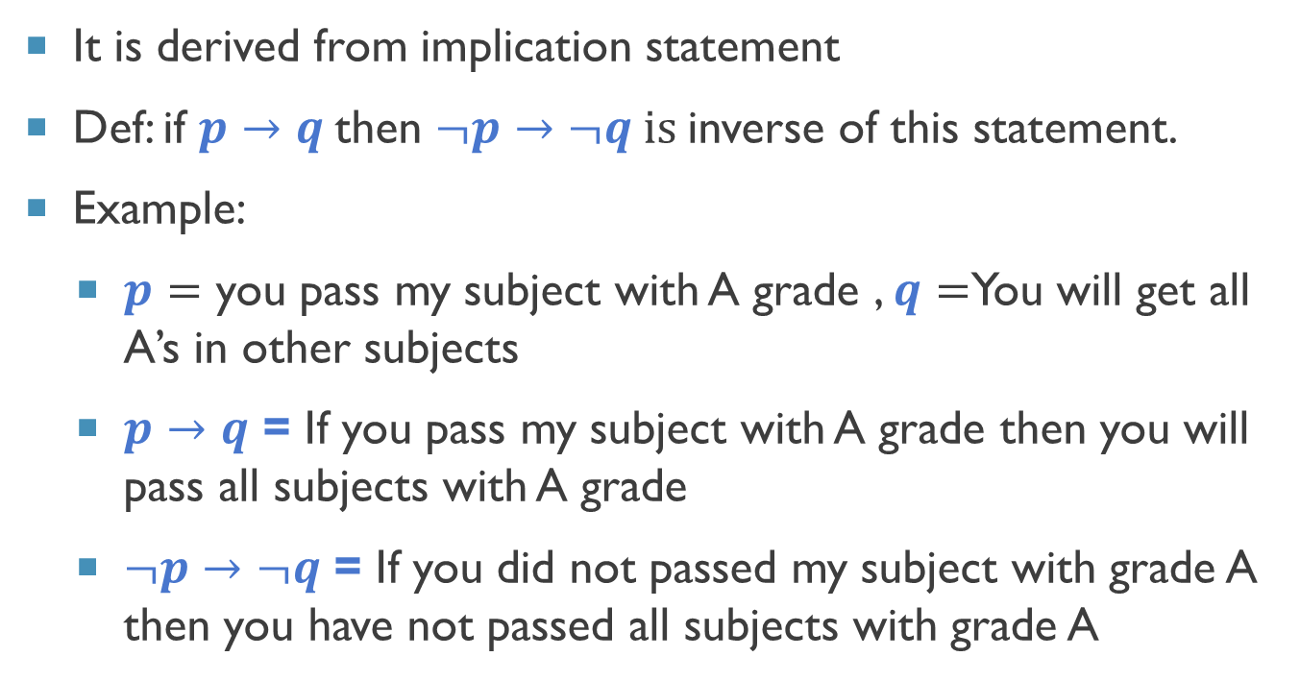
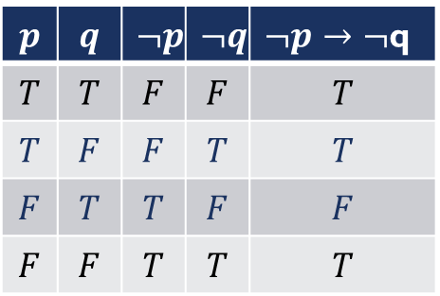
Inverse Statement
It is derived from implication statement
Def: if $p→q$then $¬p→¬q is$inverse of this statement.
Example:
$p=$ you pass my subject with A grade , $q=$You will get all A’s in other subjects
$p→q$ = If you pass my subject with A grade then you will pass all subjects with A grade
$¬p→¬q$ = If you did not passed my subject with grade A then you have not passed all subjects with grade A
$$p$$ | $$q$$ | $$p→q$$
$$T$$ | $$T$$ | $$T$$
$$T$$ | $$F$$ | $$F$$
$$F$$ | $$T$$ | $$T$$
$$F$$ | $$F$$ | $$T$$
$$p$$ | $$q$$ | $$¬p$$ | $$¬q$$ | $¬p→¬$q
$$T$$ | $$T$$ | $$F$$ | $$F$$ | $$T$$
$$T$$ | $$F$$ | $$F$$ | $$T$$ | $$T$$
$$F$$ | $$T$$ | $$T$$ | $$F$$ | $$F$$
$$F$$ | $$F$$ | $$T$$ | $$T$$ | $$T$$

Slide 12
Program for Inverse
$$Implication (p→q)$$ | $$Inverse(¬p→¬q)$$
# p = the value is less than 10 # q = the value is less than 20 p,q=8,16 if(p<10): # T print(q<20) # T p,q=8,26 if(p<10): # T print(q<20) # F p,q=18,16 if(p<10): # F print(q<20) # T ? p,q=18,26 if(p<10): # F print(q<20) # F ?
# p = the value is less than 10 # q = the value is less than 20 p,q=8,16 if(not(p<10)): # T print(not(q<20)) # T p,q=8,26 if(not(p<10)): # T print(not(q<20)) # F p,q=18,16 if(not(p<10)): # F print(not(q<20)) # T ? p,q=18,26 if(not(p<10)): # F print(not(q<20)) # F ?

Slide 13
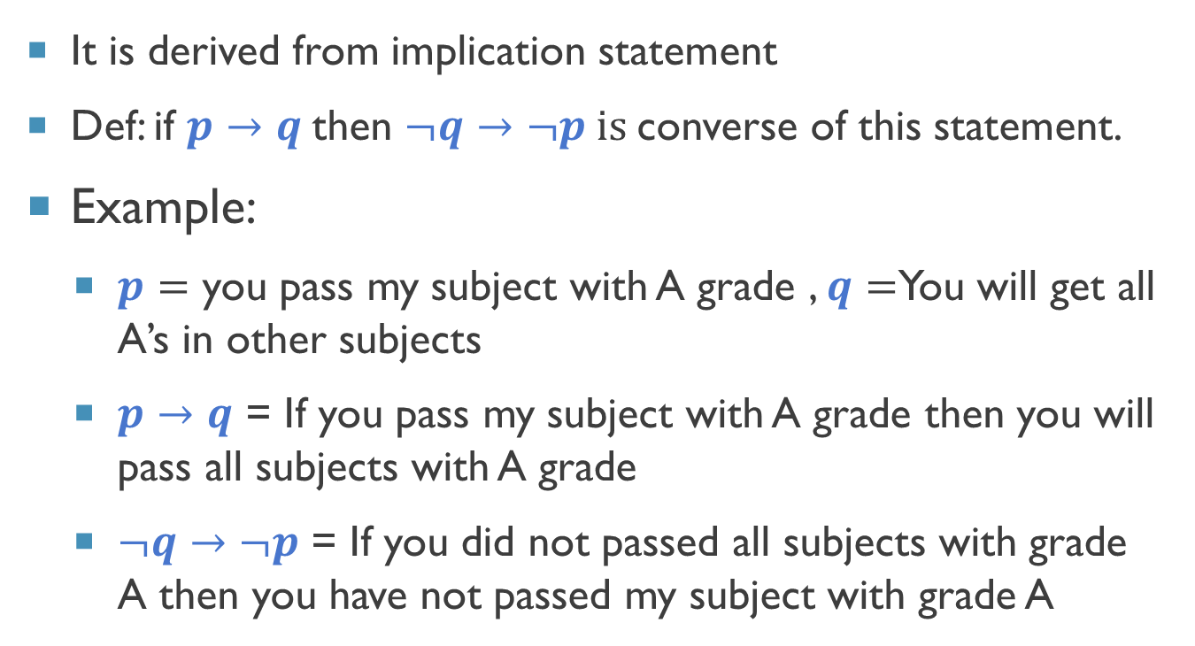
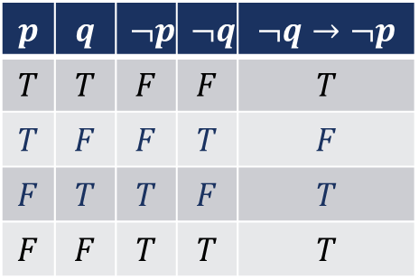
Contrapositive Statement
It is derived from implication statement
Def: if $p→q$then $¬q→¬p is$converse of this statement.
Example:
$p=$ you pass my subject with A grade , $q=$You will get all A’s in other subjects
$p→q$ = If you pass my subject with A grade then you will pass all subjects with A grade
$¬q→¬p$ = If you did not passed all subjects with grade A then you have not passed my subject with grade A
$$p$$ | $$q$$ | $$p→q$$
$$T$$ | $$T$$ | $$T$$
$$T$$ | $$F$$ | $$F$$
$$F$$ | $$T$$ | $$T$$
$$F$$ | $$F$$ | $$T$$
$$p$$ | $$q$$ | $$¬p$$ | $$¬q$$ | $$¬q→¬p$$
$$T$$ | $$T$$ | $$F$$ | $$F$$ | $$T$$
$$T$$ | $$F$$ | $$F$$ | $$T$$ | $$F$$
$$F$$ | $$T$$ | $$T$$ | $$F$$ | $$T$$
$$F$$ | $$F$$ | $$T$$ | $$T$$ | $$T$$

Slide 14
Program for contrapositive
$$Implication (p→q)$$ | $$Contrapositive(¬q→¬p)$$
# p = the value is less than 10 # q = the value is less than 20 p,q=8,16 if(p<10): # T print(q<20) # T p,q=8,26 if(p<10): # T print(q<20) # F p,q=18,16 if(p<10): # F print(q<20) # T ? p,q=18,26 if(p<10): # F print(q<20) # F ?
# p = the value is less than 10 # q = the value is less than 20 q,p=8,16 if(not(q<10)): # T print(not(p<20)) # T q,p=8,26 if(not(q<10)): # T print(not(p<20)) # F q,p=18,16 if(not(q<10)): # F print(not(p<20)) # T ? q,p=18,26 if(not(q<10)): # F print(not(p<20)) # F ?

Slide 15
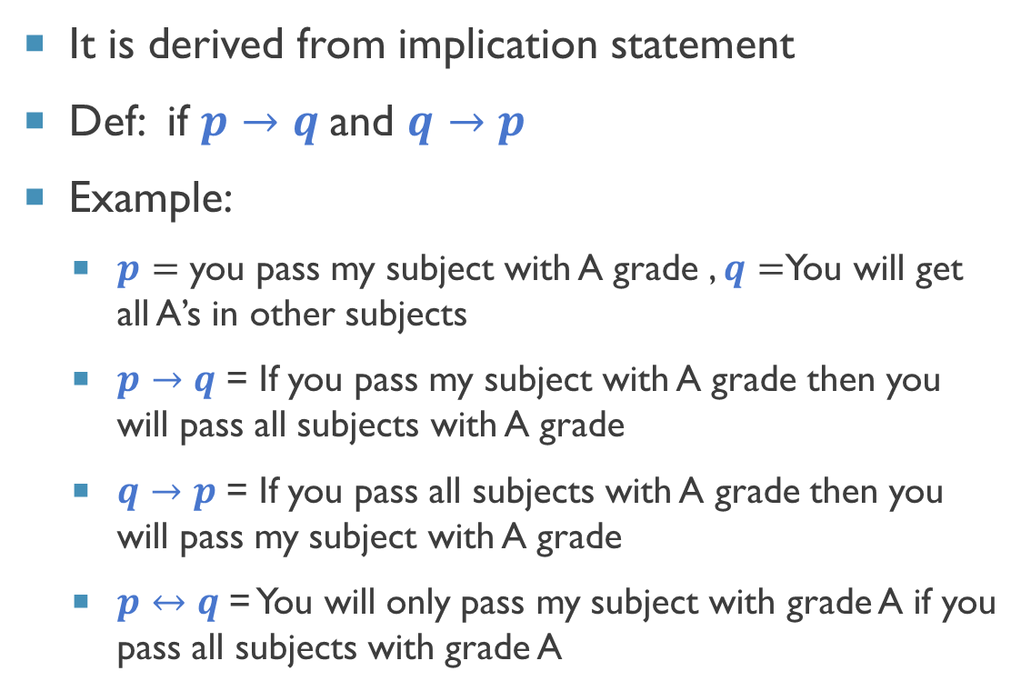
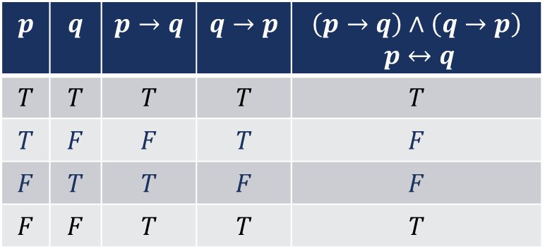
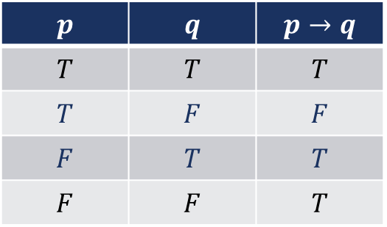
Biconditional Biconditional (bi-implications) Statement ($↔$)
It is derived from implication statement
Def: if $p→q$and $q→p$
Example:
$p=$ you pass my subject with A grade , $q=$You will get all A’s in other subjects
$p→q$ = If you pass my subject with A grade then you will pass all subjects with A grade
$q→p$ = If you pass all subjects with A grade then you will pass my subject with A grade
$p↔q$ = You will only pass my subject with grade A if you pass all subjects with grade A
$$p$$ | $$q$$ | $$p→q$$
$$T$$ | $$T$$ | $$T$$
$$T$$ | $$F$$ | $$F$$
$$F$$ | $$T$$ | $$T$$
$$F$$ | $$F$$ | $$T$$
$$p$$ | $$q$$ | $$p→q$$ | $$q→p$$ | $$\left(p→q\right)∧\left(q→p\right)$$ $$p↔q$$
$$T$$ | $$T$$ | $$T$$ | $$T$$ | $$T$$
$$T$$ | $$F$$ | $$F$$ | $$T$$ | $$F$$
$$F$$ | $$T$$ | $$T$$ | $$F$$ | $$F$$
$$F$$ | $$F$$ | $$T$$ | $$T$$ | $$T$$

Slide 16
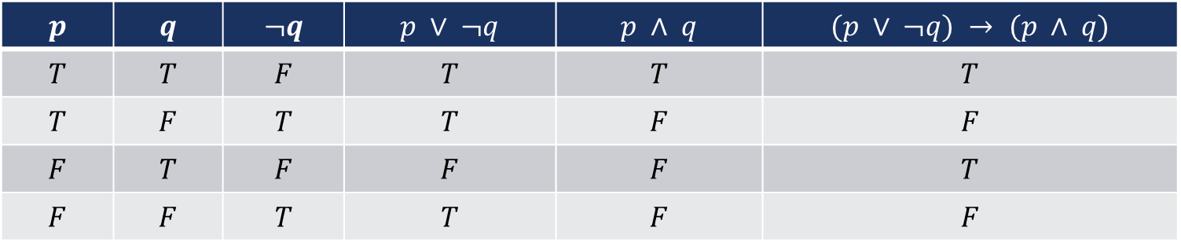

Truth tables of compound statements
We can combine the logical connectives to create complex statements
For example: $(p ∨ ¬q) → (p ∧ q)$
$$p$$ | $$q$$ | $$¬q$$ | $$p ∨ ¬q$$ | $$p ∧ q$$ | $$(p ∨ ¬q) → (p ∧ q)$$
$$T$$ | $$T$$ | $$F$$ | $$T$$ | $$T$$ | $$T$$
$$T$$ | $$F$$ | $$T$$ | $$T$$ | $$F$$ | $$F$$
$$F$$ | $$T$$ | $$F$$ | $$F$$ | $$F$$ | $$T$$
$$F$$ | $$F$$ | $$T$$ | $$T$$ | $$F$$ | $$F$$

Slide 17
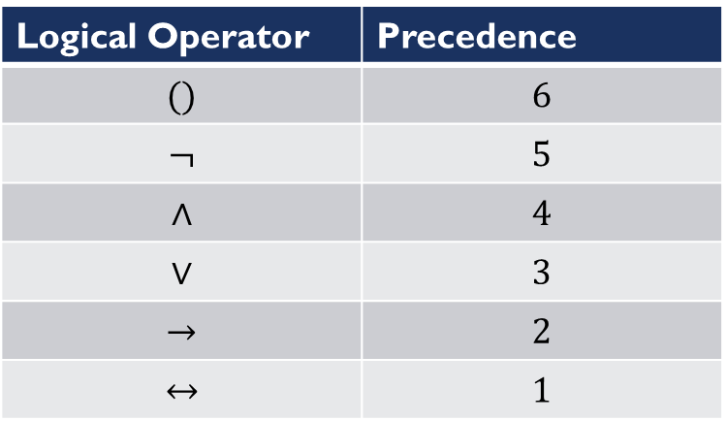
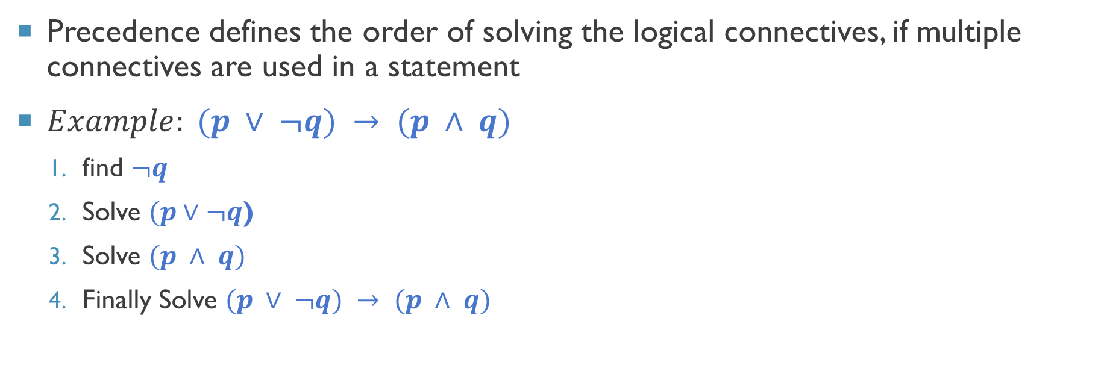
Precedence of logical operators
Precedence defines the order of solving the logical connectives, if multiple connectives are used in a statement
$Example: (p ∨ ¬q) → (p ∧ q)$
find $¬q$
Solve $(p∨¬q$)
Solve $(p ∧ q)$
Finally Solve $(p ∨ ¬q) → (p ∧ q)$
Logical Operator | Precedence
$$()$$ | $$6$$
$$¬$$ | $$5$$
$$∧$$ | $$4$$
$$∨$$ | $$3$$
$$→$$ | $$2$$
$$↔$$ | $$1$$

Slide 18
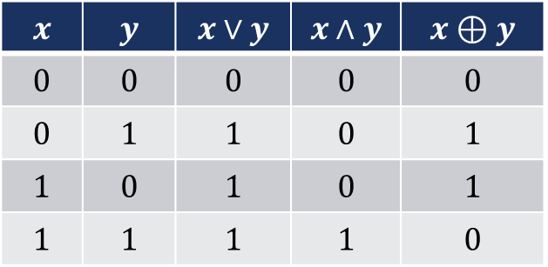
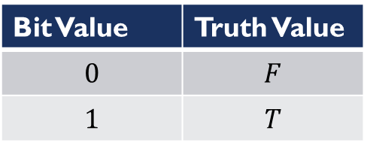
Logic and bit operators
Computers represent information in the form of bits
A bit may have value 0 or 1.
We can map bit values with truth values i.e. 0 for F and 1 for T
Boolean Variable: A variable that can take one of two values {0,1}
Computer bit operations can correspond to logical connectives
A bit-string is sequence of zero or more bits.
Number of bits in the string forms the length of the string
Example: 101101110001
Bit Value | Truth Value
$$0$$ | $$F$$
$$1$$ | $$T$$
$$x$$ | $$y$$ | $$x∨y$$ | $$x∧y$$ | $$x⊕y$$
$$0$$ | $$0$$ | $$0$$ | $$0$$ | $$0$$
$$0$$ | $$1$$ | $$1$$ | $$0$$ | $$1$$
$$1$$ | $$0$$ | $$1$$ | $$0$$ | $$1$$
$$1$$ | $$1$$ | $$1$$ | $$1$$ | $$0$$

Slide 19
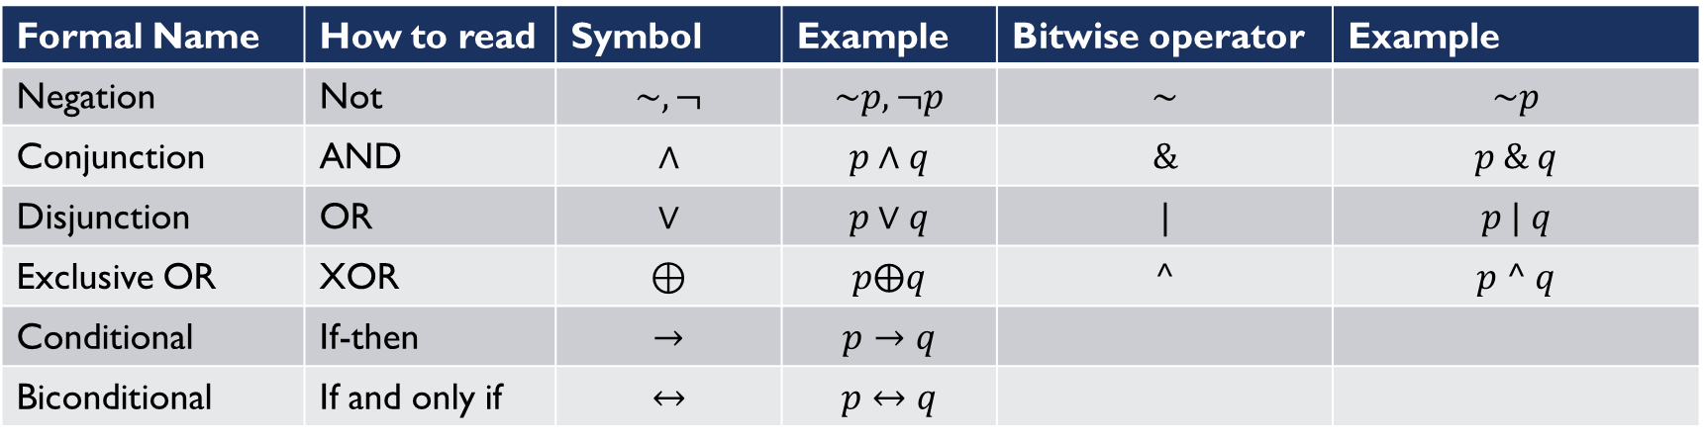
Python bitwise operators
Formal Name | How to read | Symbol | Example | Bitwise operator | Example
Negation | Not | $$\sim , ¬$$ | $$\sim p, ¬p$$ | $$\sim$$ | $$\sim p$$
Conjunction | AND | $$∧$$ | $$p∧q$$ | $$\&$$ | $$p \& q$$
Disjunction | OR | $$∨$$ | $$p∨q$$ | $$|$$ | $$p | q$$
Exclusive OR | XOR | $$⊕$$ | $$p⨁q$$ | $$^$$ | $$p ^ q$$
Conditional | If-then | $$→$$ | $$p→q$$
Biconditional | If and only if | $$↔$$ | $$p↔q$$

Slide 20
Extending the bit-operations
Bitwise OR
1 | 1 | 0 | 0
1 | 0 | 1 | 0
1 | 1 | 1 | 0
We can extend the bit operations to bit-strings
These extended operations are known as
Bitwise-AND
Bitwise-OR
Bitwise-XOR
…
Bitwise AND
1 | 1 | 0 | 0
1 | 0 | 1 | 0
1 | 0 | 0 | 0
Bitwise XOR
1 | 1 | 0 | 0
1 | 0 | 1 | 0
o | 1 | 1 | 0

Slide 21
Program for bitwise operators
p=9 q=21 print(~p) # -10 print(p&q) # 1 print(p|q) # 29 print(p^q) # 28
Knowledge of representation of
Negative and positive numbers in
Binary will help to understand the
Output of this program

Slide 22



Thanks for watching
Dr. Sajid Iqbal
Assistant Professor
Department of Computer Science
Bahauddin Zakariya University, Multan
sajidiqbal.pk@gmail.com
https://github.com/sajjo79/DiscreteMathematics
Allah Hafiz
COMEDXD

